Slide 1
Beyond the Big Rewrite
Jiří Pokorný

Slide 2



WUG Days Behind the scenes
David Gešvindr Roman Jašek

Slide 3
Jiří Pokorný
Mann-Hummel manufacturing platform developer
jiri.pokorny@mann-hummel.com
Retired WUG Organizer
DIR Scuba diving instructor
Job offers (SAP, Data engineer)
Student mentoring program
Student thesis leadership

Slide 4
Talk Motivation or bad experience?
All previous enterprises I worked for
decided to rewrite ...
Traffic systems
- migrate 200+ Delphi DLLs to C#
Network monitoring
- rewrite of DAL ended
in slower service than before
Hotels
- Write new accounting module

Slide 5
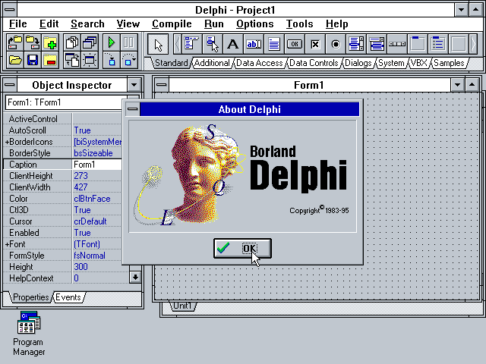



Bad examples
Netscape Navigator (1998-2000)
Microsoft Longhorn (2001-2004)
Borland Delphi .NET (2003-2006)
Google Fuchsia
(as Android replacement 2016-)

Slide 6
Common reasons complete rewrites fail
The old system contains years
of edge-case fixes that must be rediscovered.
Users often see little or no improvement
until the rewrite is complete.
The target keeps moving while the rewrite is in progress.
Existing behavior is often undocumented and hard to reproduce.
Teams spend years rebuilding what they already had
instead of delivering new capabilities.
Competitors continue releasing features
while the rewriting team is effectively paused.

Slide 7
Successful projects
  Facebook migrating much of its PHP execution
  without halting product development.
  Slack gradually rewriting parts of its desktop app.
  Dropbox progressively migrating infrastructure.
They typically shared one characteristic:
Incremental replacement rather than a "big bang" rewrite.

Slide 8
Design patterns – Isolation
Branch by Abstraction
(Libraries, services, APIs)
Anti-Corruption Layer
(Domain-driven migrations)
Facade / Gateway Pattern
(API modernization)
Feature Toggle Migration
(Continuous delivery)

Slide 9
Design patterns - Refactoring
Expand-and-Contract (Database migrations)
Service Extraction (Monolith to microservices)
Strangler Fig Pattern (Large legacy)

Slide 10
Design patterns – Data flow
Shadow Traffic
(Performance and correctness validation)
Event Interception
(Event-driven systems)
Application-first Migration
(Most enterprise applications)
Database-first Migration
(Simple CRUD systems)

Slide 11
Design patterns - Deployment
Canary Release
(High-traffic web applications)
Blue-Green Deployment
(Cloud-native applications)
Parallel Run (Dual Run)
(Financial, healthcare, ERP)

Slide 12
Common pattern combinations
A typical sequence of multiple patterns used to reduce risk:
Introduce a Facade/Gateway to control routing.
Use the Strangler Fig Pattern
to replace features incrementally.
Apply Branch by Abstraction within the codebase
for component-level changes.
Protect deployments with Feature Toggles
and Canary Releases.
Migrate the database using Expand-and-Contract.
Validate the new implementation with Shadow Traffic
or Parallel Run before fully retiring the legacy system.

Slide 13
Rewrite Success in numbers
There is no reliable statistic!
(My own AI compiled estimations)
Typical findings:
60–80% of organizations begin modernization
by incrementally replacing components.
10–20% attempt complete rewrites.
Of those complete rewrites,
many are later scaled back into phased migrations.

Slide 14
Costs of rewrite
Instead of asking "How much will a rewrite cost?", ask:
At what point does a rewrite become economically justified?
Rework effort estimation - Instead of estimating an entire rewrite, estimate the effort required to remove
accumulated technical debt.
Estimate a rewrite as a new development project and compare with maintenance or incremental reengineering.

Slide 15

Don't forget to cover estimations
Requirements recovery - rebuild specification
Parallel maintenance
Feature catch-up
Data migration
Cutover and training

Slide 16
AI estimated costs
Break point for greenfield:
touching 70-90% of modified code
If no understanding is available:
1,5x estimated costs
Rewrite costs:
1.5x - 2.5x the total project costs.

Slide 17

Lessons learned?
Most of the rewrites are not justified
Missing resources
No risks assessment
My recommendation?
Rewrite only as last resort

